Slide 1
Performance Evaluation
ML LAB
Dr. J.Shana
14-07-2026

Slide 2
Evaluation
Evaluation = Process of judging the merit or worth of something
Evaluation is key to building effective and efficient ML systems
Why?
There are many models/ algorithms/ systems, which one is the best?

Slide 3
Regression / Classification Models
Predictive modeling / Supervised learning
A model is a specification of mathematical/probabilistic relationships that exist between different variables
The goal is usually to use existing data to develop models that we can use to predict outcomes for new data, such as
Predicting whether an email message is spam or not
Predicting whether a credit card transaction is fraudulent
Predicting which advertisement a shopper is most likely to click on
Predicting which football team is going to win the Super Bowl
Predicting stock price of a given company
Predicting number of buyers of a certain product
Predicting user ratings of a new movie
Predicting the grade of a disease
Nominal
(categorical with
No particular order)
Continuous / ordinal

Slide 4
Performance evaluation
How predictive is the model we learned?
For regression, usually R² or MSE
For classification, many options
Accuracy can be used, with caution
Performance on the training data (data used to build models) is not a good indicator of performance on future data
Q: Why?
A: Because new data will probably not be exactly the same as the training data!

Slide 5
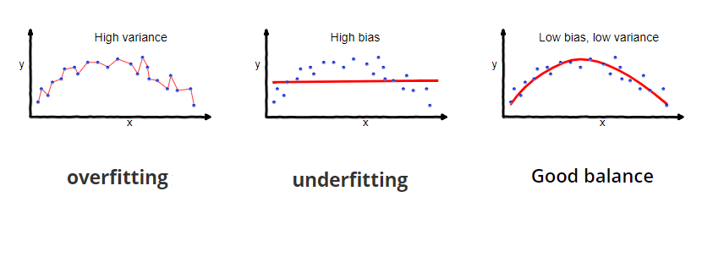
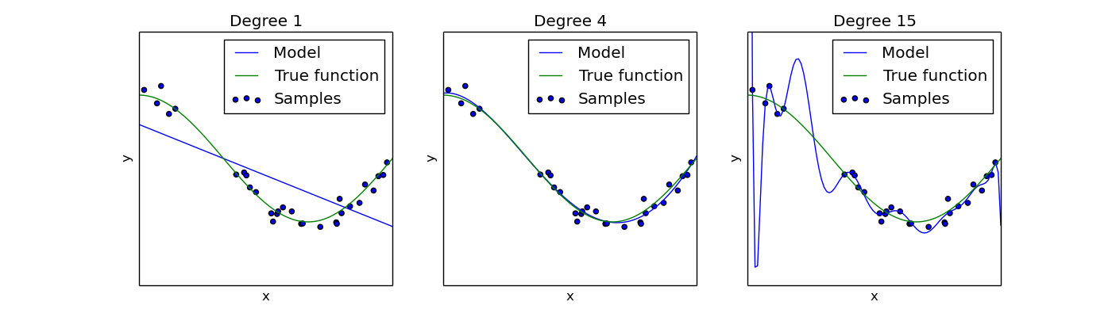
Overfitting vs underfitting
Overfitting – fitting the training data too precisely - usually leads to poor results on new data
Underfitting – model does not fit training data well
Underfitting
Overfitting
High bias, low variance
Low bias, high variance
Increase # of features or complexity of model
Get more training data, or reduce # of features or complexity of model
Notes:
Bias is the difference between the av
Variance is the amount that the estimate of the target function will change if different training data was used.erage prediction of model and the correct value which we are trying to predict.

Slide 6
Evaluation on “LARGE” data
If many (thousands) of examples are available, then how can we evaluate our model?
A simple evaluation is sufficient
Randomly split data into training and test sets (e.g. 2/3 for train, 1/3 for test)
For classification, make sure training and testing have similar distribution of class labels
Build a model using the train set and evaluate it using the test set.

Slide 7
Model Evaluation Step 1: Split data into train and test sets
THE PAST
Results Known
0
Training set
3
2
5
Data
1
Testing set

Slide 8
Model Evaluation Step 2: Build a model on a training set
THE PAST
Results Known
0
Training set
3
2
5
Data
1
Model Builder
Testing set

Slide 9
Model Evaluation Step 3: Evaluate on test set
Results Known
0
Training set
3
2
5
Data
1
Model Builder
Evaluate
Predictions
3
4
1
2
Y
N
Testing set

Slide 10
A note on parameter tuning
It is important that the test data is not used in any way to build the model
Some learning schemes operate in two stages:
Stage 1: builds the basic structure
Stage 2: optimizes parameter settings
The test data can’t be used for parameter tuning!
Proper procedure uses three sets: training data, validation data, and test data
Validation data is used to optimize parameters

Slide 11
Evaluation on “small” data, 1
The holdout method reserves a certain amount for testing and uses the remainder for training
Usually: one third for testing, the rest for training
For “unbalanced” datasets, samples might not be representative
Few or none instances of some classes
Stratified sample: advanced version of balancing the data
Make sure that each class is represented with approximately equal proportions in both subsets

Slide 12
Evaluation on “small” data, 2
What if we have a small data set?
The chosen 2/3 for training may not be representative.
The chosen 1/3 for testing may not be representative.

Slide 13
Cross-validation
Cross-validation more useful in small datasets
First step: data is split into k subsets of equal size
Second step: each subset in turn is used for testing and the remainder for training
This is called k-fold cross-validation
For classification, often the subsets are stratified before the cross-validation is performed
The error estimates are averaged to yield an overall error estimate

Slide 14
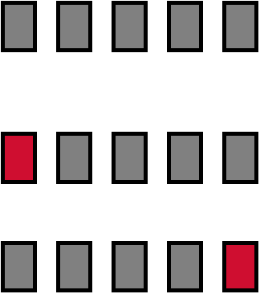
Cross-validation example:
Break up data into groups of the same size
Hold aside one group for testing and use the rest to build model
Repeat
Test
14

Slide 15
More on cross-validation
Standard method for evaluation: stratified ten-fold cross-validation
Why ten? Extensive experiments have shown that this is the best choice to get an accurate estimate
Stratification reduces the estimate’s variance
Even better: repeated stratified cross-validation
E.g. ten-fold cross-validation is repeated ten times and results are averaged (reduces the variance)

Slide 16
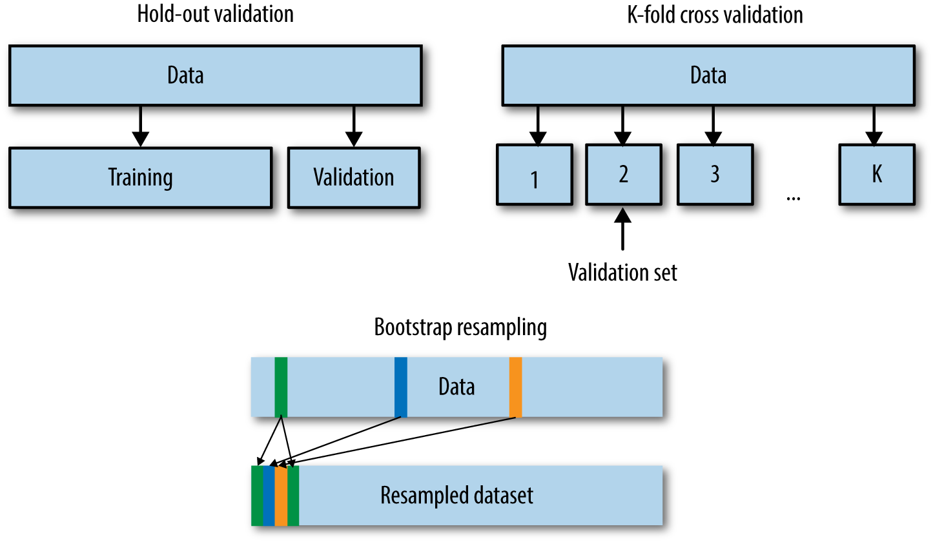
The bootstrap
CV uses sampling without replacement
The same instance, once selected, can not be selected again for a particular training/test set
The bootstrap uses sampling with replacement to form the training set
Sample a dataset of n instances n times with replacement to form a new dataset of n instances
Use this data as the training set
Use the instances from the original dataset that don’t occur in the new training set for testing

Slide 17
The bootstrap
The bootstrap approach allows us to use a computer to mimic the process of obtaining new data sets, so that we can estimate the variability of our estimate without generating additional samples.
Rather than repeatedly obtaining independent data sets from the population, we instead obtain distinct data sets by repeatedly sampling observations from the original data set with replacement.
Each of these “bootstrap data sets” is created by sampling with replacement, and is the same size as our original dataset. As a result some observations may appear more than once in a given bootstrap data set and some not at all.

Slide 18
Confusion Matrix
A confusion matrix is a table that is often used to describe the performance of a classification model (or "classifier") on a set of test data
true positives (TP): These are cases in which we predicted positive (they have the disease), and they do have the disease.
true negatives (TN): We predicted negative, and they don't have the disease.
false positives (FP): We predicted positive, but they don't actually have the disease. (Also known as a "Type I error.")
false negatives (FN): We predicted negative, but they actually do have the disease. (Also known as a "Type II error.")
 | Actual: Positive | Actual: Negative
Predicted: Positive | tp | fp
Predicted: Negative | fn | tn

Slide 19
Metric | Formula | Question Answered
Precision | ( {TP}/{TP+FP} ) | Of all predicted positives, how many were correct?
Recall | ( {TP}/{TP+FN} ) | Of all actual positives, how many were found?
High Precision → Few false alarms.
High Recall → Few missed positive cases.

Slide 20
Accuracy
Measures overall correctness of predictions.
Formula:
Accuracy = (TP + TN)/(TP + TN + FP + FN)
Focus: Overall model performance.
Limitation: Can be misleading for imbalanced datasets.

Slide 21
Precision
Measures correctness of positive predictions.
Formula:
Precision = TP/(TP + FP)
Question: Of all predicted positives, how many are truly positive?
Useful when false positives are costly.
If many genuine emails are marked as spam, users may miss important messages. Therefore, high Precision is important because we want emails classified as spam to truly be spam.
An authorized employee tries to enter, but the system predicts "Intruder."

Slide 22
Recall (Sensitivity)
Measures ability to find actual positives.
Formula:
Recall = TP/(TP + FN)
Question: Of all actual positives, how many were identified?
Useful when false negatives are costly.
A patient actually has cancer, but the model predicts that the patient is healthy.

Slide 23
Specificity
Measures ability to identify actual negatives.
Formula:
Specificity = TN/(TN + FP)
Question: Of all actual negatives, how many were identified correctly?
High specificity means very few healthy people are incorrectly diagnosed as sick.

Slide 24
Recall finds the sick people. Specificity correctly clears the healthy people.
Recall for positive class
Specificity for negative class

Slide 25
F1 Score
Balances Precision and Recall.
Formula:
F1 = 2 × (Precision × Recall)/(Precision + Recall)
Useful for imbalanced datasets.
Example : Spam Email Detection
Low Precision → Genuine emails go to spam.
Low Recall → Spam emails reach the inbox.
A balance is required, so F1 Score is useful.
In network security:
False Positive → Normal users are flagged as attackers.
False Negative → Actual attackers are missed.

Slide 26
Summary
Accuracy: Overall correctness
Precision: Quality of positive predictions
Recall: Ability to find positives
F1 Score: Balance of Precision and Recall
Specificity: Ability to identify negatives

Slide 27
from sklearn.metrics import accuracy_score
from sklearn.metrics import precision_score
from sklearn.metrics import recall_score
from sklearn.metrics import f1_score
print("Accuracy:", accuracy_score(y_true, y_pred))
print("Precision:", precision_score(y_true, y_pred))
print("Recall:", recall_score(y_true, y_pred))
print("F1 Score:", f1_score(y_true, y_pred))

Slide 28
Recall-Precision Graph
The Recall-Precision Graph is created using the standard Recall values from the Recall Level and Precision Averages.
Typically these graphs slope downward from left to right, enforcing the notion that as more relevant documents are retrieved (recall increases), the more nonrelevant documents are retrieved (precision decreases).
This graph is the most commonly used method for comparing systems. The plots of different runs can be superimposed on the same graph to determine which run is superior.
Curves closest to the upper right-hand corner of the graph (where recall and precision are maximized) indicate the best performance

Slide 29
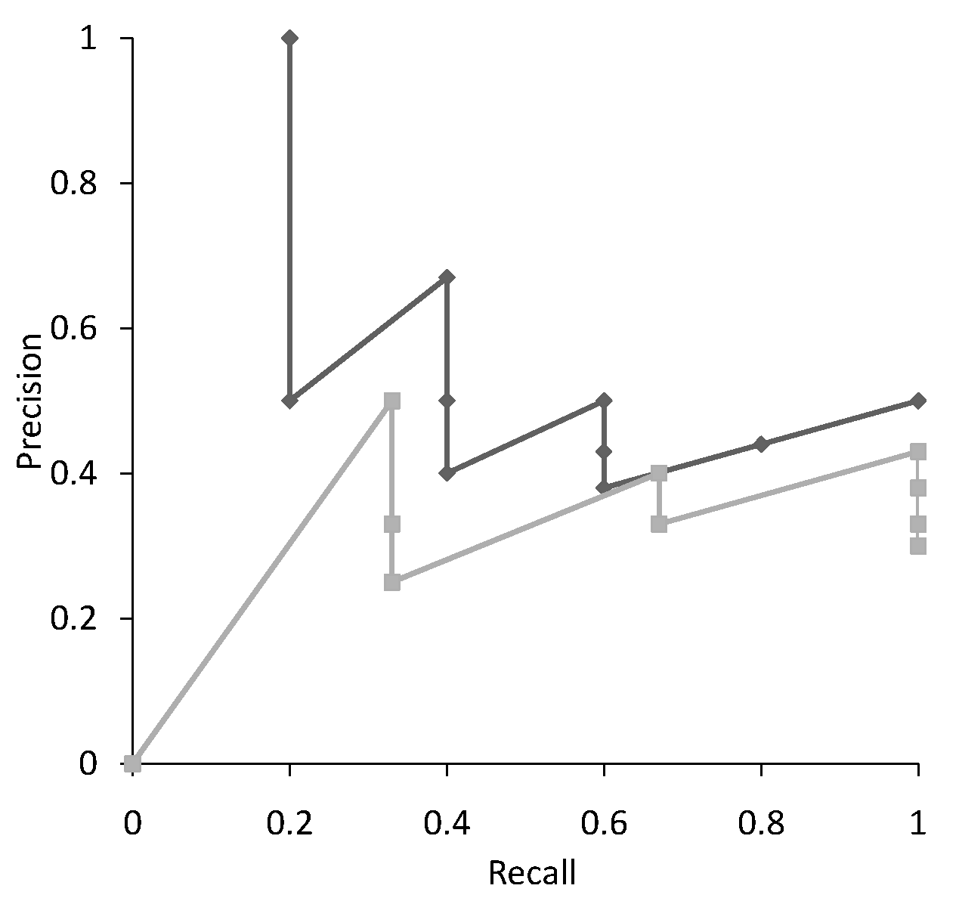
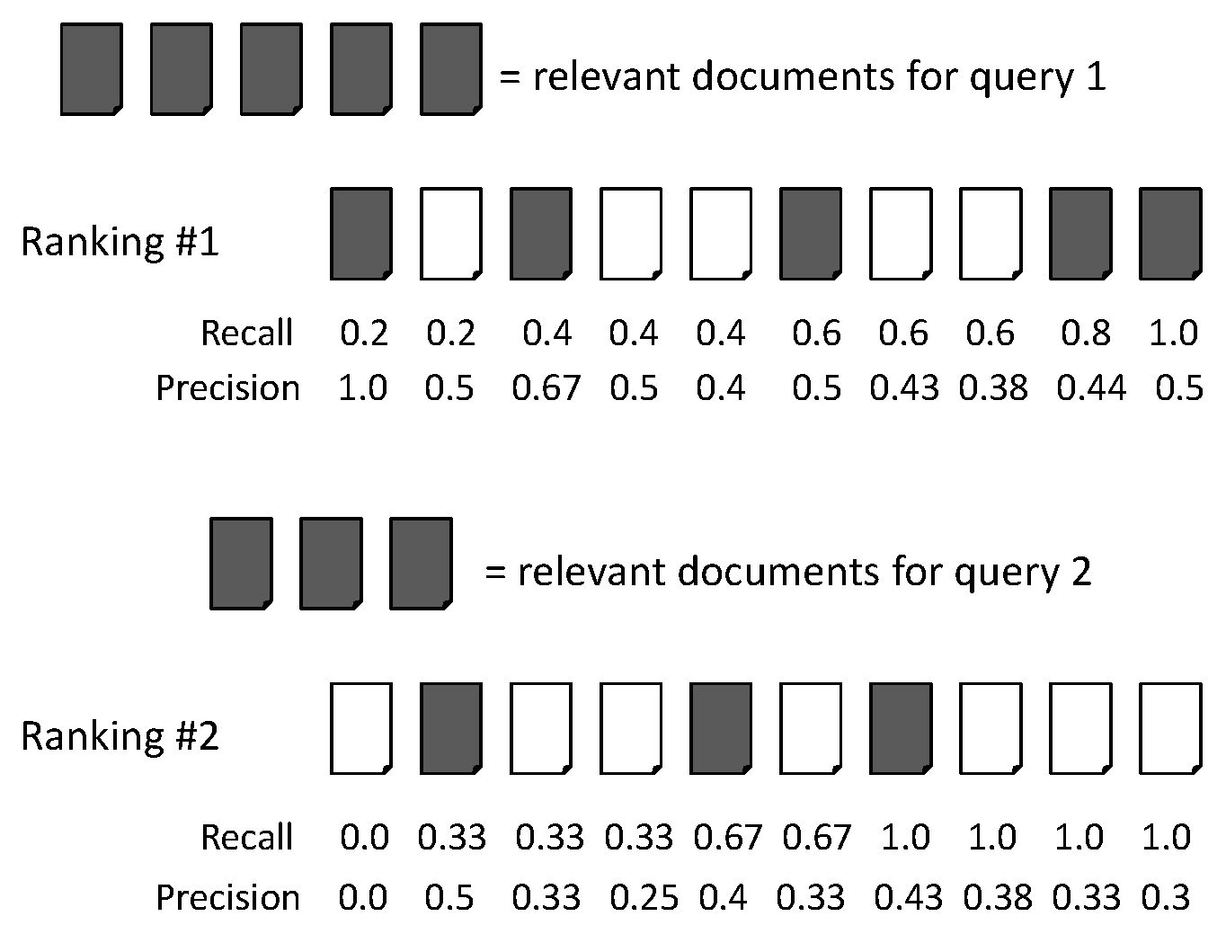
Recall-Precision Graph
Multiple precision for some recalls

Slide 30
ROC Curves
A receiver operating characteristic curve, i.e. ROC curve, is a graphical plot that illustrates the diagnostic ability of a binary classifier system as its discrimination threshold is varied.
The diagnostic performance of a test, or the accuracy of a test to discriminate diseased cases from normal cases is evaluated using Receiver Operating Characteristic (ROC) curve analysis
A ROC Curve is a way to compare diagnostic tests. It is a plot of the true positive rate against the false positive rate.

Slide 31
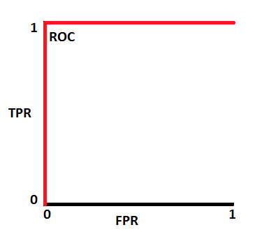
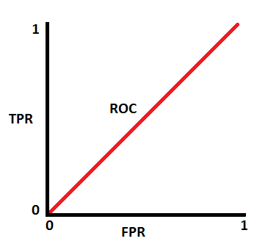
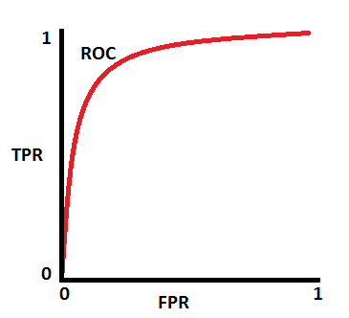
ROC Curves
This is an ideal situation. Model has an ideal measure of separability. It is perfectly able to distinguish between positive class and negative class.
This is the worst situation. When AUC is approximately 0.5, model has no discrimination capacity to distinguish between positive class and negative class. Random predictions.
Notes:
AUC ROC indicates how well the probabilities from the positive classes are separated from the negative classes.
When we decrease the threshold, we get more positive values thus increasing the sensitivity. Meanwhile, this will decrease the specificity.
Similarly, when we increase the threshold, we get more negative values thus increasing the specificity and decreasing sensitivity.
Specificity gives us the True Negative Rate and (1 — Specificity) gives us the False Positive Rate.

Slide 32
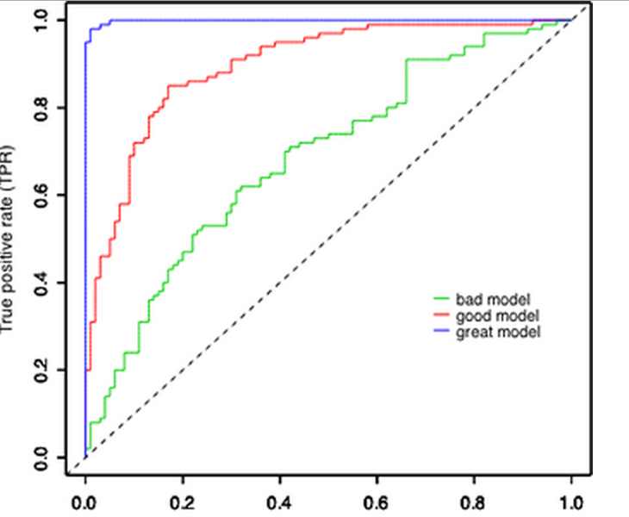
Multiple ROC Curves
Comparison of multiple classifiers is usually straight-forward especially when no curves cross each other. Curves close to the perfect ROC curve have a better performance level than the ones closes to the baseline.

Slide 33
PR Curves Vs ROC Curves
Remember, a ROC curve represents a relation between sensitivity (Recall) and False Positive Rate (Not Precision).
ROC curve plot True Positive Rate Vs. False Positive Rate; Whereas, PR curve plot Precision Vs. Recall.
If your question is, "How well can this classifier be expected to perform in general, go with a ROC curve
If true negative is not much valuable to the problem, or negative examples are abundant. Then, PR-curve is typically more appropriate.
For example, if the class is highly imbalanced and positive samples are very rare, then use PR-curve.
How meaningful is a positive result from my classifier

Slide 34
Cost-Sensitive Learning
Learning to minimize the expected cost of misclassifications
Most classification learning algorithms attempt to minimize the expected number of misclassification errors
In many applications, different kinds of classification errors have different costs, so we need cost-sensitive methods

Slide 35
Examples of Applications with Unequal Misclassification Costs
Medical Diagnosis:
Cost of false positive error: Unnecessary treatment; unnecessary worry
Cost of false negative error: Postponed treatment or failure to treat; death or injury
Fraud Detection:
False positive: resources wasted investigating non-fraud
False negative: failure to detect fraud could be very expensive

Slide 36
Cost Matrix
Model 1: Confusion matrix
Model 2: Confusion matrix
 | P | N
P | 150 | 40
N | 60 | 250
 | P | N
P | 250 | 45
N | 5 | 200
Actual
FN
Actual
FP
Predicted
Predicted
Cost matrix
 | P | N
P | -1 | 100
N | 1 | 0
Accuracy: 80%
Cost: 150x-1 + 40x100 + 60x1=3910
Accuracy: 90%
Cost: 250x-1 + 45x100 +5x1 = 4255
If we are focusing on accuracy then we will go with the Model 2 (In this case we need to compromise on cost) , however if we are focusing on cost then we will go with the Model 1 (In this case we need to compromise on accuracy).

